Slide 1

NETWORK PROGRAMMING
with
TCP/UDP Sockets

Slide 2
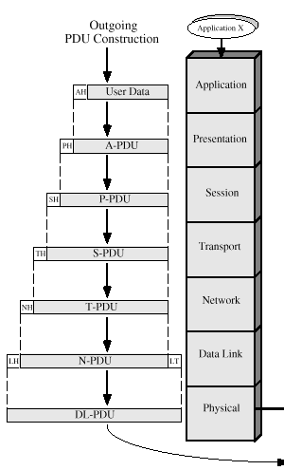
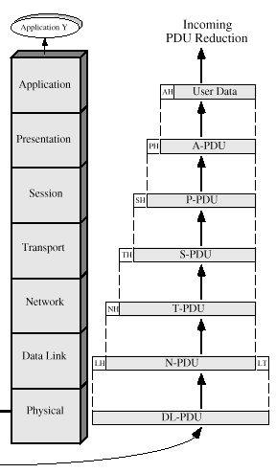
OSI Architecture
Physical Network
NP-MCA-SAEC
09-Jan-18

Slide 3
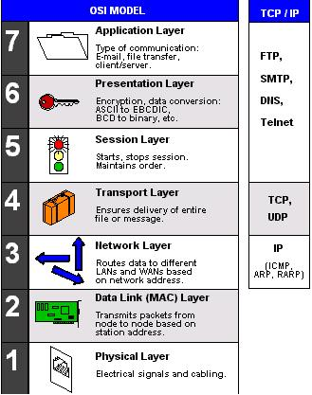
User and System Programs
Kernel Support Hardware
NP-MCA-SAEC
09-Jan-18

Slide 4
Networking Basics
Computers running on the Internet communicate to each other using either
  TCP (Transmission Control Protocol) or
  UDP (User Datagram Protocol)
When you write C programs that communicate over the network, you are programming at the application layer
  Typically, you don’t need to concern yourself with TCP and UDP layers
application
presentation
session
transport
network
data link
physical
application
TCP, UDP, …
IPv4, IPv6
device driver
& hardware
sockets
API
OSI model
Internet protocol suite
NP-MCA-SAEC
09-Jan-18

Slide 5
TCP
Definition
  A connection-based protocol that provides a reliable flow of data between two computers
  e.g. if you want to speak to your aunt, a connection is established when dial her number and she answers
TCP guarantees that
  data sent from one end of the connection actually gets to the other end
  and in the same order it was sent
  (otherwise, and error is reported)
e.g.
  HTTP, FTP, Telnet, etc.
NP-MCA-SAEC
09-Jan-18

Slide 6
TCP Connections
Host A
Host B
131.181.7.22
128.10.2.3
1069
25
Process
Process
1557
Process
Process
80
Process
Process
1111
NP-MCA-SAEC
09-Jan-18

Slide 7
TCP Header Format
1 byte
1 byte
1 byte
1 byte
Source Port
Destination Port
Sequence Number
Acknowledgement Number
Hlength
Reserved
Control
Window
Checksum
Urgent Pointer
Options & Padding (if any)
Data
NP-MCA-SAEC
09-Jan-18

Slide 8
UDP
Definition
  A protocol that sends independent packets of data, called datagrams, from one computer to another with no guarantees about arrival
  e.g. sending a letter through the postal service
UDP is not connection-based like TCP
  the order of delivery is not important and is not guaranteed
  each message is independent of any other
Why we use UDP?
  Some forms of communication don’t require such strict reliability
  Reliable connection may require extra overhead
e.g.
  Clock server and its clients, Ping,
NP-MCA-SAEC
09-Jan-18

Slide 9
UDP Datagram Format
1 byte
1 byte
1 byte
1 byte
Source Port
Destination Port
Total Length
Checksum
Data
NP-MCA-SAEC
09-Jan-18

Slide 10
Comparing IP, UDP & TCP
IP - unreliable datagram delivery between hosts.
UDP - unreliable datagram delivery between processes (with minimal overhead).
TCP - reliable, byte-stream delivery between processes.
NP-MCA-SAEC
09-Jan-18

Slide 11
IP Protocol
0 15 16 31
Removed (6)
  ID, Flags, frag offset
  TOS, hlen
  header checksum
Changed: (3)
  total length=> payload
  protocol => next header
  TTL=> hop limit
Added: (2)
  traffic class
  flow label
Expanded
  address 32 bits to 128 bits
vers hlen TOS total length
identification flags frag offset
TTL protocol header checksum
source address
destination address
options and padding
20
bytes
IPv4
vers traffic class flow label
pay load length next header hop limit
source address
destination address
40
bytes
IPv6
NP-MCA-SAEC
09-Jan-18

Slide 12
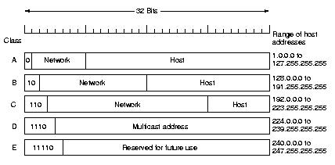
Network Layer In The Internet
IPV4 Addresses
Address Classes
The Internet designers were unsure whether the world would evolve into a few networks with many hosts (e.g., large networks), or many networks each supporting only a few hosts (e.g., small networks).
Thus, Internet addresses handle both large and small networks.
Internet address are four bytes in size, where:
Class A addresses start with a `0' in the most significant bit, followed by a 7-bit network address and a 24-bit local part.
Class B addresses start with a `10' in the two most significant bits, followed by a 14-bit network number and a 16-bit local part.
Class C addresses start with a `110' in the three most significant bits, followed by a 21-bit network number and an 8-bit local part.
Class D addresses start with a `1110' in the four most significant bits, followed by a 28-bit group number. Used for multicast.
Class E addresses start with a ‘11110’ and are reserved for future use.
NP-MCA-SAEC
09-Jan-18

Slide 13
TCP/IP Protocol Structure
SMTP
FTP
Telnet
DNS
SNMP
HTTP
UDP
TCP
ICMP
IGMP
IP
ARP
RARP
DATA LINK
PHYSICAL
NP-MCA-SAEC
09-Jan-18

Slide 14
Client-Server Architecture
response
Client
Server
request
Client requests service from server
Server responds with sending service or error message to client
NP-MCA-SAEC
09-Jan-18

Slide 15
Client/sever model Cont…
Client asks (request) – server provides (response)
Typically: single server - multiple clients
The server does not need to know anything about the client
  even that it exists
The client should always know something about the server
  at least where it is located
1. Client sends request
Client
process
Server
process
Resource
4. Client
handles
response
3. Server sends response
2. Server
handles
request
Note: clients and servers are processes running on hosts
(can be the same or different hosts).
NP-MCA-SAEC
09-Jan-18

Slide 16
Internet Connections (TCP/IP)
Address the machine on the network
  By IP address
Address the process
  By the “port”-number
The pair of IP-address + port – makes up a “socket-address”
Client socket address
128.2.194.242:3479
Server socket address
208.216.181.15:80
Client
Server
(port 80)
Connection socket pair
(128.2.194.242:3479, 208.216.181.15:80)
Client host address
128.2.194.242
Server host address
208.216.181.15
Note: 3479 is an
ephemeral port allocated
by the kernel
Note: 80 is a well-known port
associated with Web servers
NP-MCA-SAEC
09-Jan-18

Slide 17
Addresses, Ports and Sockets
Like apartments and mailboxes
  You are the application
  Your apartment building address is the address
  Your mailbox is the port
  The post-office is the network
  The socket is the key that gives you access to the right mailbox (one difference: assume outgoing mail is placed by you in your mailbox)
  Q: How do you choose which port a socket connects to?
NP-MCA-SAEC
09-Jan-18

Slide 18
Port
Definition
  The TCP and UDP protocols use ports to map incoming data to a particular process running on a computer
  cf. IP address
    used for delivering data to the right computer on the network
How does the computer know to which application to forward the received data?
0~1024: reserved for well-known services
app
app
app
app
0~65,535
port
port
port
port
TCP or UDP
packet
NP-MCA-SAEC
port # data
09-Jan-18

Slide 19
Port numbers
16-bit integer
Differentiate a socket-related process from another
Ranges
  Well-known ports (0 ~1023): assigned by IANA
    e.g.) FTP (21), web server (80), …
  Registered ports (1024 ~ 49151): recommendation list
    e.g.) X Window server (6000 ~ 6003)
  Dynamic or private ports (49152 ~ 65535)
NP-MCA-SAEC
09-Jan-18

Slide 20

Ports
Each host has 65,536 ports
Some ports are reserved for specific apps
  20,21: FTP
  23: Telnet
  80: HTTP
  see RFC 1700 (about 2000 ports are reserved)
Port 0
Port 1
Port 65535
A socket provides an interface to send data to/from the network through a port
NP-MCA-SAEC
09-Jan-18

Slide 21
Clients
Examples of client programs
  Web browsers, ftp, telnet, ssh
How does a client find the server?
  The IP address in the server socket address identifies the host
  The (well-known) port in the server socket address identifies the service, and thus implicitly identifies the server process that performs that service.
  Examples of well known ports
    Port 7: Echo server
    Port 23: Telnet server
    Port 25: Mail server
    Port 80: Web server
NP-MCA-SAEC
09-Jan-18

Slide 22
Using Ports to Identify Services
Server host 128.2.194.242
Client host
Service request for
128.2.194.242:80
(i.e., the Web server)
Web server
(port 80)
Client
Kernel
Echo server
(port 7)
Service request for
128.2.194.242:7
(i.e., the echo server)
Web server
(port 80)
Client
Kernel
Echo server
(port 7)
NP-MCA-SAEC
09-Jan-18

Slide 23
Servers
Servers are long-running processes (daemons).
  Created at boot-time (typically) by the init process (process 1)
  Run continuously until the machine is turned off.
Each server waits for requests to arrive on a well-known port associated with a particular service.
  Port 7: echo server
  Port 23: telnet server
  Port 25: mail server
  Port 80: HTTP server
Other applications should choose between 1024 and 65535
See /etc/services for a comprehensive list of the services available on a Linux machine.
NP-MCA-SAEC
09-Jan-18

Slide 24
Socket
Definition
  One end-point of a two-way communication link between two programs running on a network
A socket is bound to a specific port number so that the TCP layer can identify the application that data is destined to be sent
The client and server can communicate by writing to or reading from their sockets
  similar to file descriptor
connection request
Server
Server
port
port
Client
Port
port
Client
connection
NP-MCA-SAEC
09-Jan-18

Slide 25
Sockets
What is a socket?
  To the kernel, a socket is an endpoint of communication.
  To an application, a socket is a file descriptor that lets the application read/write from/to the network.
    Remember: All Unix I/O devices, including networks, are modeled as files.
Clients and servers communicate with each by reading from and writing to socket descriptors.
The main distinction between regular file I/O and socket I/O is how the application “opens” the socket descriptors.
NP-MCA-SAEC
09-Jan-18

Slide 26
What is a socket?
An interface between application and network
  The application creates a socket
  The socket type dictates the style of communication
    reliable vs. best effort
    connection-oriented vs. connectionless
Once configured the application can
  pass data to the socket for network transmission
  receive data from the socket (transmitted through the network by some other host)
NP-MCA-SAEC
09-Jan-18

Slide 27
Types of Internet Sockets
Different types of sockets implement different communication types (stream vs. datagram)
Type of socket: stream socket
  connection-oriented
  two way communication
  reliable (error free), in order delivery
  can use the Transmission Control Protocol (TCP)
  e.g. telnet, ssh, http
Type of socket: datagram socket
  connectionless, does not maintain an open connection, each packet is independent
  can use the User Datagram Protocol (UDP)
  e.g. IP telephony
Other types exist: similar to the one above
NP-MCA-SAEC
09-Jan-18

Slide 28
Two essential types of sockets
SOCK_STREAM
  a.k.a. TCP
  reliable delivery
  in-order guaranteed
  connection-oriented
  bidirectional
SOCK_DGRAM
  a.k.a. UDP
  unreliable delivery
  no order guarantees
  no notion of “connection” – app indicates dest. for each packet
  can send or receive
App
App
D1
3
2
1
socket
Dest.
3
2
D2
1
socket
D3
Q: why have type SOCK_DGRAM?
NP-MCA-SAEC
09-Jan-18

Slide 29
Simple Client-Server Example
response
Client
Server
request
socket()
connect()
send()
recv()
close()
socket()
bind()
listen()
accept()
recv()
send()
recv()
close()
Connection
establishment
Data request
Data response
End-of-file notification
NP-MCA-SAEC
09-Jan-18

Slide 30
Header Files
<sys/types.h> - prerequisite typedefs
<errno.h> - names for “errorno” values
<sys/socket.h> - struct socket addr; sys prototypes and constants.
<netdb.h> - N/w info lookup prototypes
<netinet/in.h> - struct sockaddr_in; byte ordering macros
<arpa/inet.h> - utility function prototypes
NP-MCA-SAEC
09-Jan-18

Slide 31
#include’s
#include <stdio.h> /* for printf() and fprintf() */
#include <sys/socket.h> /* for socket(), connect(),
sendto(), and recvfrom() */
#include <arpa/inet.h> /* for sockaddr_in and
inet_addr() */
#include <stdlib.h> /* for atoi() and exit() */
#include <string.h> /* for memset() */
#include <unistd.h> /* for close() */
#define MAX 255 /* Longest string to echo */
NP-MCA-SAEC
09-Jan-18

Slide 32
Socket Address Structure
Generic socket address structure
IPv4 socket address structure
struct sockaddr
{
uint8_t sa_len; // length of structure
unsigned short sa_family; // address family
// PF_INET, PF_INET6, PF_UNIX,…
char sa_data[14]; // family-specific address info.
}
struct sockaddr_in
{
uint8_t sa_len;
unsigned short sa_family; // PF_INET
in_port_t sin_port; // 16-bit TCP or UDP port number
struct in_addr sin_addr; // 32-bit IPv4 address
char sin_zero[8]; // unused
}
NP-MCA-SAEC
09-Jan-18

Slide 33
Address and port byte-ordering
Address and port are stored as integers
  u_short sin_port; (16 bit)
  in_addr sin_addr; (32 bit)
struct in_addr {
u_long s_addr;
};
Problem:
  different machines / OS’s use different word orderings
    little-endian: lower bytes first
    big-endian: higher bytes first
  these machines may communicate with one another over the network
Big-Endian
machine
Little-Endian
machine
12.40.119.128
128.119.40.12
WRONG!!!
NP-MCA-SAEC
128
119
40
12
128
119
40
12
09-Jan-18

Slide 34
Solution: Network Byte-Ordering
Defs:
  Host Byte-Ordering: the byte ordering used by a host (big or little)
  Network Byte-Ordering: the byte ordering used by the network – always big-endian
Any words sent through the network should be converted to Network Byte-Order prior to transmission (and back to Host Byte-Order once received)
Q: should the socket perform the conversion automatically?
Q: Given big-endian machines don’t need conversion routines and little-endian machines do, how do we avoid writing two versions of code?
NP-MCA-SAEC
09-Jan-18

Slide 35
Byte Ordering Solution
There are two solutions if computers with different byte ordering system want to communicate
  They must know the kind of architecture of the sending computer
  (bad solution, it has not been implemented)
  Introduction of a network byte order. The functions are:
uint16_t htons(uint16_t host16bitvalue)
uint32_t htonl(uint32_t host32bitvalue)
uint16_t ntohs(uint16_t net16bitvalue)
uint32_t ntohl(uint32_t net32bitvalue)
Note: use for all integers (short and long), which are sent across the network
  Including port numbers and IP addresses
NP-MCA-SAEC
09-Jan-18

Slide 36
UNIX’s byte-ordering funcs
u_long ntohl(u_long x);
u_short ntohs(u_short x);
u_long htonl(u_long x);
u_short htons(u_short x);
On big-endian machines, these routines do nothing
On little-endian machines, they reverse the byte order
Same code would have worked regardless of endian-ness of the two machines
Big-Endian
machine
Little-Endian
machine
12
128.119.40.12
128
119
40
12
40
119
128
128.119.40.12
htonl
128
119
40
12
ntohl
128
119
40
12
NP-MCA-SAEC
09-Jan-18

Slide 37
Network Byte Ordering
Network is big-endian, host may be big- or little-endian
  Functions work on 16-bit (short) and 32-bit (long) values
  htons() / htonl() : convert host byte order to network byte order
  ntohs() / ntohl(): convert network byte order to host byte order
  Use these to convert network addresses, ports, …
struct sockaddr_in serveraddr;
/* fill in serveraddr with an address */
…
/* Connect takes (struct sockaddr *) as its second argument */
connect(clientfd, (struct sockaddr *) &serveraddr,
sizeof(serveraddr));
…
NP-MCA-SAEC
09-Jan-18

Slide 38
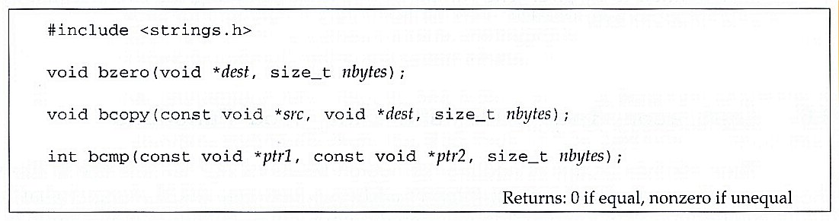
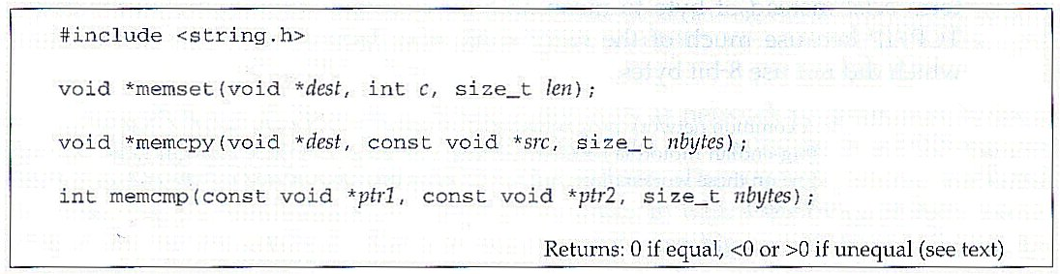
Byte Manipulation Functions
Berkeley-derived functions
ANSI C
NP-MCA-SAEC
09-Jan-18

Slide 39
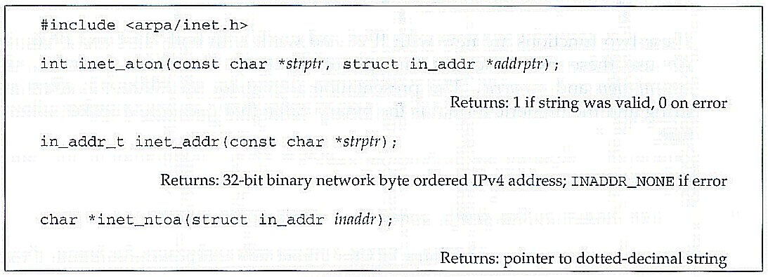
Address Conversion Functions
Convert IPv4 address
  Between a dotted-decimal string and its 32-bit network byte ordered binary value
NP-MCA-SAEC
09-Jan-18

Slide 40
TCP Sockets
bind()
socket()
TCP Client
listen()
TCP Server
socket()
accept()
connection established
(TCP three-way handshake)
blocks until connection from client
connect()
write()
data (request)
read()
process request
read()
data (reply)
write()
close()
end-of-file notification
read()
close()
NP-MCA-SAEC
09-Jan-18

Slide 41
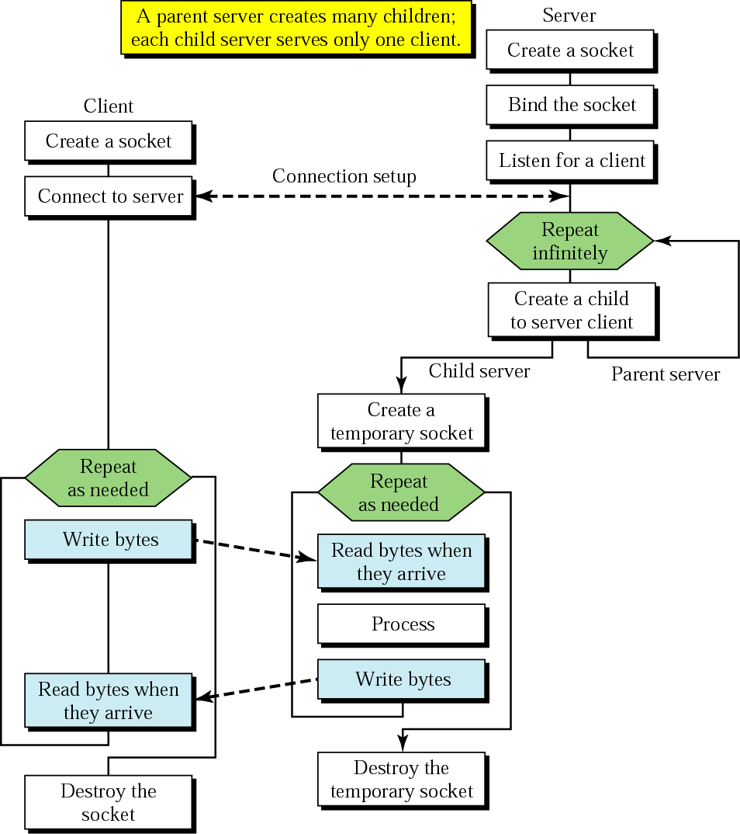
Client+server: connection-oriented
BIND
SOCKET
LISTEN
CONNECT
TCP three-way handshake
ACCEPT
SEND
RECEIVE
SEND
RECEIVE
CLOSE
NP-MCA-SAEC
09-Jan-18
Concurrent server

Slide 42
Example: Server Programming
create stream socket (socket() )
Bind port to socket (bind() )
Listen for new client (listen() )
While
  Wait for (select() )
(depending on which file descriptors are ready)
  accept user connection and create a new socket (accept() )
  data arrives from client (recv() )
  data has to be send to client (send() )
NP-MCA-SAEC
09-Jan-18

Slide 43
Example: Client Programming
Create stream socket (socket() )
Connect to server (connect() )
While still connected:
  send message to server (send() )
  receive (recv() ) data from server and process it
Close TCP connection and Socket (close())
NP-MCA-SAEC
09-Jan-18

Slide 44
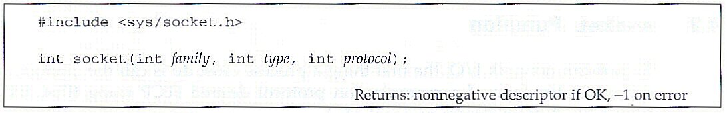
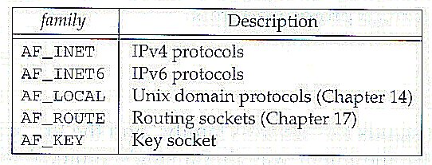
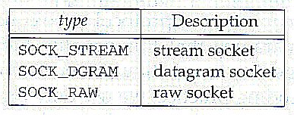
Socket() Function
Definition
Protocol family constants & Socket type
Protocol argument is normally set to 0 except for raw socket
NP-MCA-SAEC
09-Jan-18

Slide 45
connect()
#include <sys/socket.h>
int connect( int sockfd, const struct sockaddr * servaddr, socklen_t addrlen );
Returns: 0 if OK, -1 on error
e.g. connect()
  struct sockaddr_in servaddr;
  ...
  servaddr.sin_family = PF_INET;
  servaddr.sin_addr.s_addr = htonl( “220.95.133.100” );
  servaddr.sin_port = htons( 7 ); // 7 for echo service
  if( connect( sockfd, (struct sockaddr *)&servaddr, sizeof(servaddr) ) < 0 )
  { ... }
  ...
NP-MCA-SAEC
09-Jan-18

Slide 46
bind()
#include <sys/socket.h>
int bind( int sockfd, const struct sockaddr * myaddr, socklen_t addrlen );
Returns: 0 if OK, -1 on error
Process specifies |  | Result
IP address | Port
Wildcard | 0 | Kernel chooses IP address and port
Wildcard | Non-zero | Kernel chooses IP address, process specifies port
Local IP address | 0 | Process specifies IP address and kernel chooses port
Local IP address | Non-zero | Process specifies IP address and port
e.g. bind()
  myaddr.sin_family = PF_INET;
  myaddr.sin_addr.s_addr = htonl( INADDR_ANY );
  myaddr.sin_port = htons( 7 ); // 7 for echo service
  if( bind( sockfd, (struct sockaddr *)&myaddr, sizeof(myaddr) ) < 0 ) { ... }
NP-MCA-SAEC
09-Jan-18

Slide 47
listen() and accept()
#include <sys/socket.h>
int listen( int sockfd, int backlog );
Returns: 0 if OK, -1 on error
int accept( int sockfd, struct sockaddr * cliaddr, socklen_t * addrlen )
Returns: non-negative descriptor if OK, -1 on error
e.g. listen()
  #define LISTENQ 5
  ...
  if( listen( mysock, LISTENQ ) < 0 ) { ... }
  while( 1 ){
  clilen = sizeof( cliaddr );
  if( ( clisockfd = accept( mysock, (struct sockaddr *)&cliaddr, &clilen ) ) < 0 ) { ... }
  ...
  }
NP-MCA-SAEC
09-Jan-18

Slide 48
recv() and send()
#include <sys/types.h>
#include <sys/socket.h>
int recv( int sockfd, void * buff, size_t len, int flags );
int send( int sockfd, const void * buff, size_t len, int flags );
Both return: number of bytes read or written if OK, -1 on error
e.g. send() and recv()
  if( ( n = send( sockfd, buff, len, 0 ) ) != len ){ ... }
  ...
  if( ( n = recv( sockfd, buff, BUFMAX, 0 ) ) < 0 ) { ... }
NP-MCA-SAEC
09-Jan-18

Slide 49
Basic TCP Socket I/O
Read()
  # include <unistd.h>
  int read(int sockfd, char *ptr, size_t nbytes);
  Returns: number of bytes read, -1 on error
Write()
  # include <unistd.h>
  int write(int sockfd, char *ptr, size_t nbytes);
  Returns: number of bytes written, -1 on error
NP-MCA-SAEC
09-Jan-18

Slide 50
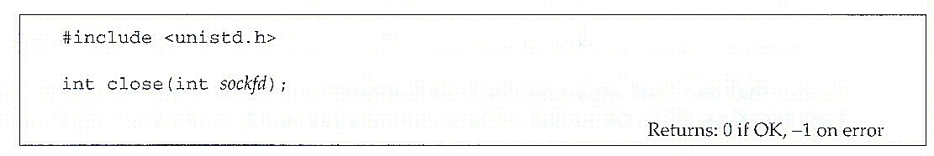
Close() Function
Definition
NP-MCA-SAEC
09-Jan-18

Slide 51
Server Example
#include <stdio.h>
#include <string.h>
#include <unistd.h>
#include <pthread.h>
#include <arpa/inet.h>
#include <sys/types.h>
#include <sys/socket.h>
#define MYPORT 3490 // the port users will be connecting to
#define BACKLOG 10 // how many pending connections queue will hold
int main(void) {
int sockfd, new_fd; // listen on sockfd, new connection on new_fd
struct sockaddr_in my_addr; // my address information
struct sockaddr_in their_addr; // connector's address information
int sin_size;
if ((sockfd = socket(AF_INET, SOCK_STREAM, 0)) == -1) { perror("socket");
exit(1);
}
my_addr.sin_family = AF_INET; // host byte order
my_addr.sin_port = htons(MYPORT); // short, network byte order
my_addr.sin_addr.s_addr = INADDR_ANY; // auto. filled with local IP
memset(&(my_addr.sin_zero), '\0', 8); // zero the rest of the struct
NP-MCA-SAEC
09-Jan-18

Slide 52
if (bind(sockfd, (struct sockaddr *)&my_addr, sizeof(struct sockaddr)) == -1) {
perror("bind");
exit(1);
}
if (listen(sockfd, BACKLOG) == -1) {
perror("listen");
exit(1);
}
while(1) { // main accept() loop
sin_size = sizeof(struct sockaddr_in);
if ((new_fd = accept(sockfd, (struct sockaddr *)&their_addr, &sin_size)) == -1) {
perror("accept");
continue;
}
printf("server: got connection from %s\n", inet_ntoa(their_addr.sin_addr));
if (send(new_fd, "Hello, world!\n", 14, 0) == -1)
perror("send");
close(new_fd);
}
return 0;
}
NP-MCA-SAEC
09-Jan-18

Slide 53
Client Example
#include <stdio.h>
#include <stdlib.h>
#include <string.h>
#include <unistd.h>
#include <arpa/inet.h>
#include <sys/types.h>
#include <sys/socket.h>
#include <netinet/in.h>
#include <netdb.h>
#define PORT 3490 // the port client will be connecting to
#define MAXDATASIZE 100 // max number of bytes we can get
// at once
int main(int argc, char *argv[]) {
int sockfd, numbytes;
char buf[MAXDATASIZE];
struct hostent *he;
struct sockaddr_in their_addr; // server's address information
if (argc != 2) {
fprintf(stderr,"usage: client hostname\n");
exit(1);
}
if ((he=gethostbyname(argv[1])) == NULL) { // get the host info
perror("gethostbyname");
exit(1);
}
if ((sockfd = socket(AF_INET, SOCK_STREAM, 0)) == -1) {
perror("socket");
exit(1);
}
NP-MCA-SAEC
09-Jan-18

Slide 54
their_addr.sin_family = AF_INET; // host byte order
their_addr.sin_port = htons(PORT); // short, network byte order
their_addr.sin_addr = *(struct in_addr *)*he->h_addr_list; // already network byte order
memset(&(their_addr.sin_zero), '\0', 8); // zero the rest of the struct
if (connect(sockfd, (struct sockaddr *)&their_addr, sizeof(struct sockaddr)) == -1){
perror("connect");
exit(1);
}
if ((numbytes=recv(sockfd, buf, MAXDATASIZE-1, 0)) == -1) {
perror("recv");
exit(1);
}
buf[numbytes] = '\0';
printf("Received: %s",buf);
close(sockfd);
return 0;
}
NP-MCA-SAEC
09-Jan-18

Slide 55
UDP Sockets
socket()
bind()
UDP Server
UDP Client
recvfrom()
socket()
blocks until datagram received from client
sendto()
data (request)
process request
data (reply)
sendto()
recvfrom()
close()
NP-MCA-SAEC
09-Jan-18

Slide 56
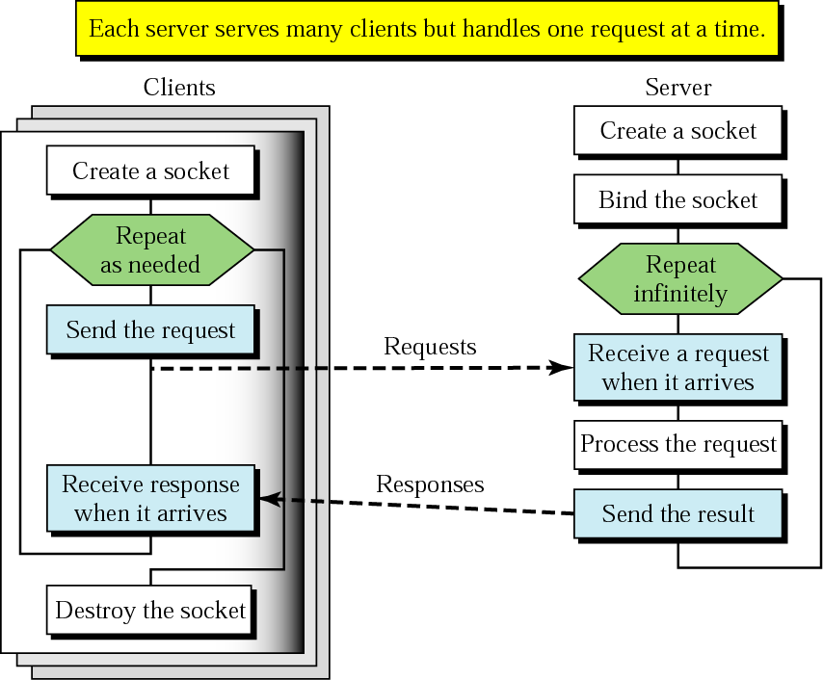
Client+server: connectionless
CREATE
BIND
RECEIVE
SEND
CLOSE
NP-MCA-SAEC
09-Jan-18

Slide 57
recvfrom() and sendto()
#include <sys/socket.h>
ssize_t recvfrom( int sockfd, void * buff, size_t nbytes, int flags, struct sockaddr * from, socklen_t * addrlen );
ssize_t sendto( int sockfd, const void * buff, size_t nbytes, int flags, const struct sockaddr * to, socklen_t addrlen )
Both return: number of bytes read or written if OK, -1 on error
e.g. recvfrom() and sendto()
  #define MAXLINE 255
  char mesg[ MAXLINE ];
  ...
  while( 1 )
  {
  if( ( n = recvfrom( sockfd, mesg, MAXLINE, 0, cliaddr, &len ) ) < 0 ) { ... }
  sendto( sockfd, mesg, n, 0, cliaddr, len );
  ...
  }
NP-MCA-SAEC
09-Jan-18

Slide 58
Basic UDP Socket I/O (1)
sendto()
  # include <sys/socket.h>
  int sendto(int s, const void *msg, int len, unsigned int flags,
  const struct sockaddr *to, int tolen);
  Returns: number of bytes sent, -1 on error
recvfrom()
  # include <sys/socket.h>
  int recvfrom(int s, void *buf, int len, unsigned int flags,
  struct sockaddr *from, int *fromlen);
  Returns: number of bytes received, -1 on error
NP-MCA-SAEC
09-Jan-18

Slide 59
Server: Alternative Ways of Handling Many Clients
Forking a new process for each client: fork()
But, creating new process is expensive.
Multithreaded implementation: have one thread handling each client.
Thread is like a process but light-weighted.
NP-MCA-SAEC
09-Jan-18

Slide 60
Compile & Run
Compile
  Server
    $sand>gcc server.c –o server
    $rain>gcc client.c –o client
Run
  Server
    $sand>./server
  Client
    $rain>./client sand.cise.ufl.edu
NP-MCA-SAEC
09-Jan-18

Slide 61
Concurrent vs. Iterative
An iterative server handles a single client request at one time.
A concurrent server can handle multiple client requests at one time.
NP-MCA-SAEC
09-Jan-18

Slide 62
Concurrent vs. Iterative
Concurrent
Large or variable size requests
Harder to program
Typically uses more system resources
Iterative
Small, fixed size requests
Easy to program

Slide 63
Connectionless vs.
Connection-Oriented
Connection-Oriented
EASY TO PROGRAM
transport protocol handles the tough stuff.
requires separate socket for each connection.
Connectionless
less overhead
no limitation on number of clients
NP-MCA-SAEC
09-Jan-18

Slide 64
Per-Client Process
e.g. fork()
  ...
  while( 1 )
  {
  clilen = sizeof( cliaddr );
  if( ( clisockfd = accept( mysock, (struct sockaddr *)&cliaddr,
  &clilen ) ) < 0 ) { ... }
  // fork child process
  if( ( pid = fork() ) < 0 ) { ... }
  else if( pid == 0 ) // child process
  {
  close( mysock );
  HANDLE_REQUEST( clisockfd );
  exit( 0 );
  }
  // parent process
  ...
  }
NP-MCA-SAEC
09-Jan-18

Slide 65
END

